Slide 1

Sri Ganesh College of Arts and Science
Department of Computer Applications
DATA MINING WAREHOUSING
Speaker : Mr.K.ARAVINDHAN

Slide 2


Slide 3
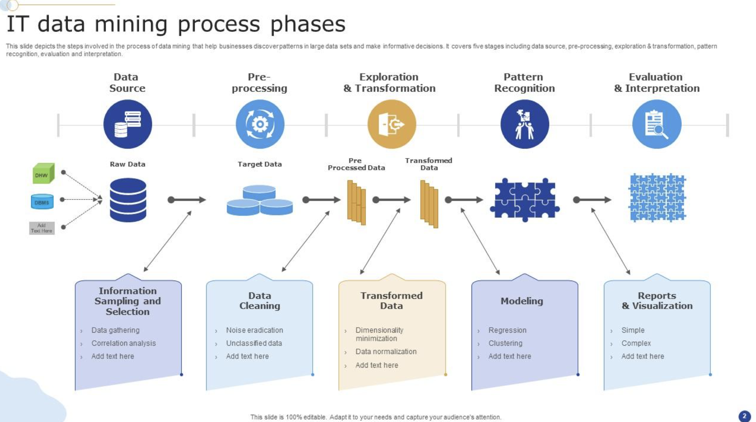

Slide 4
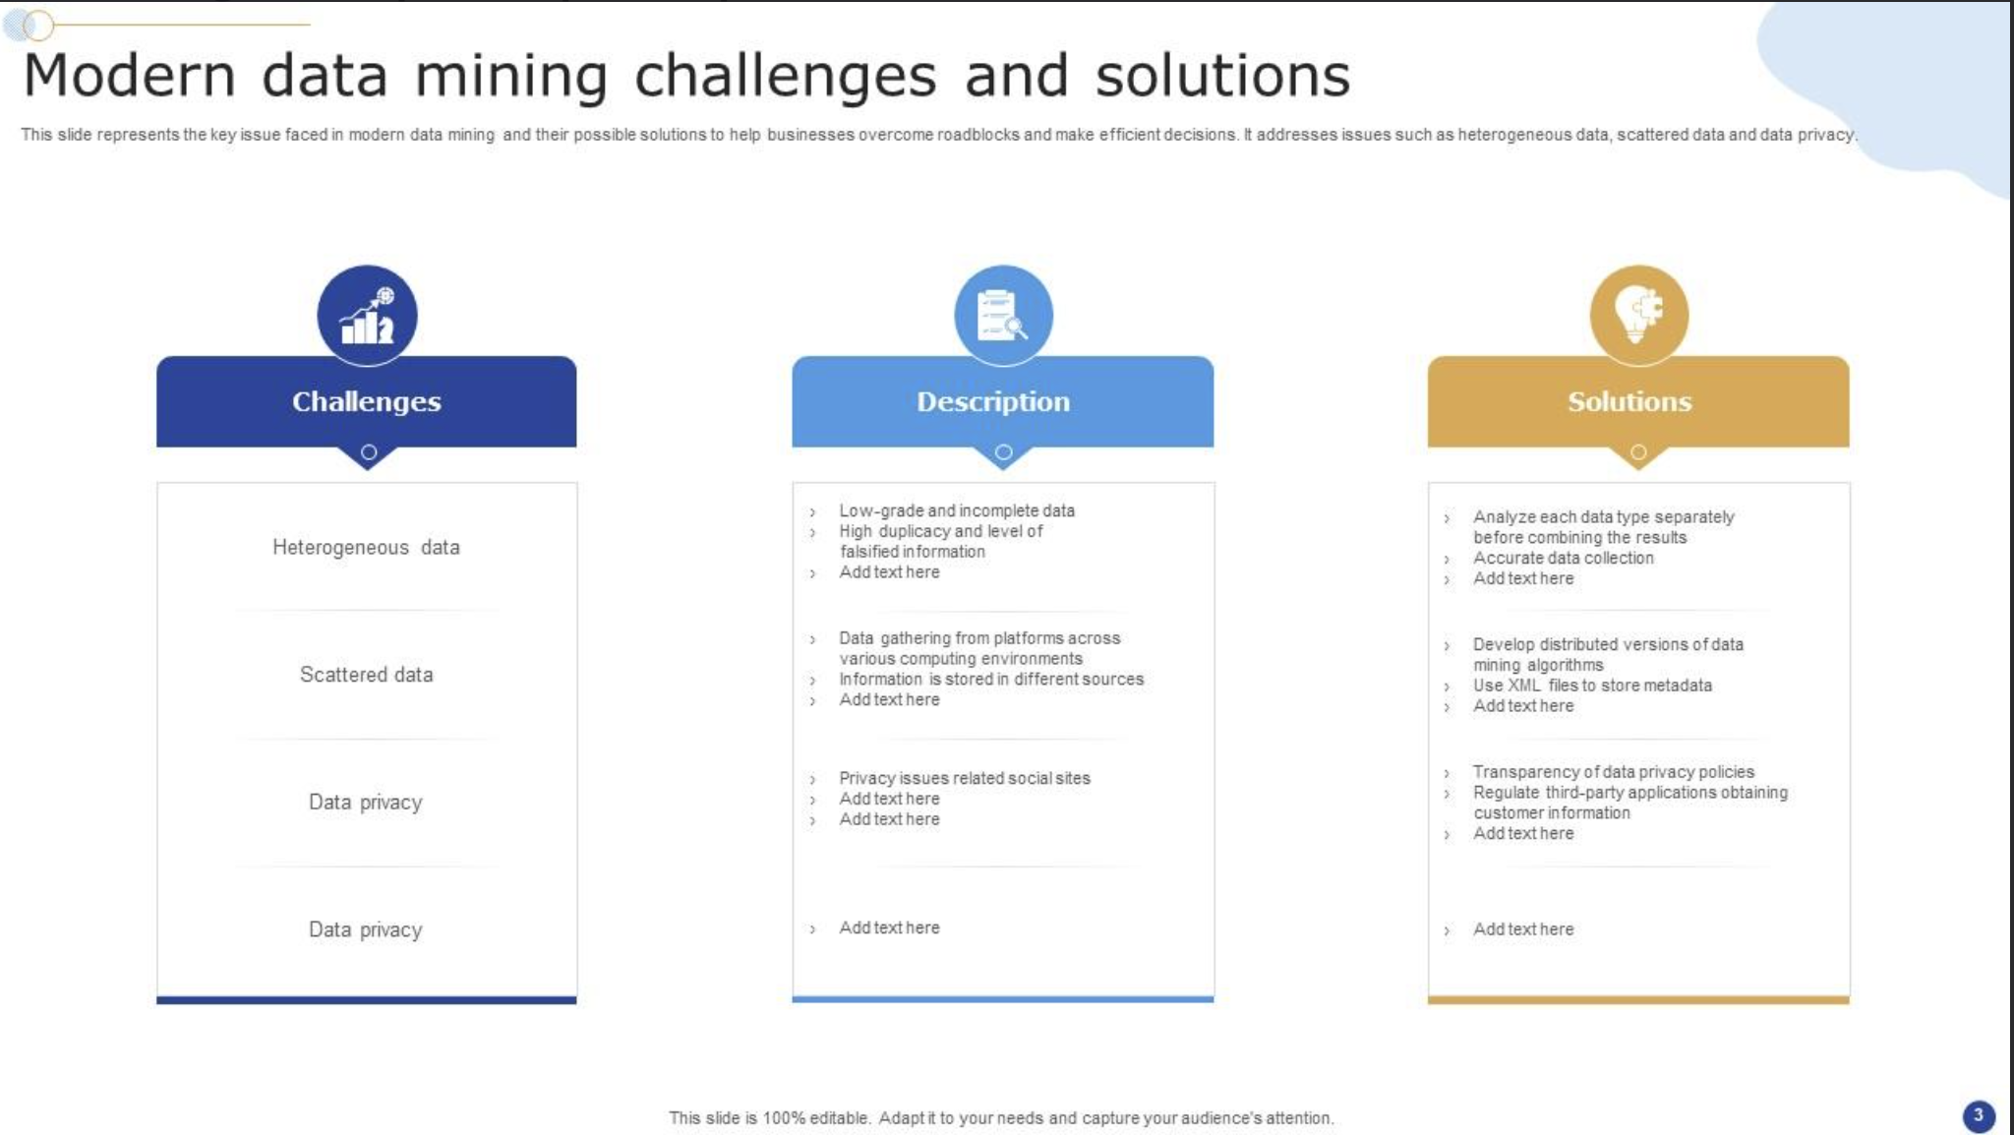

Slide 5
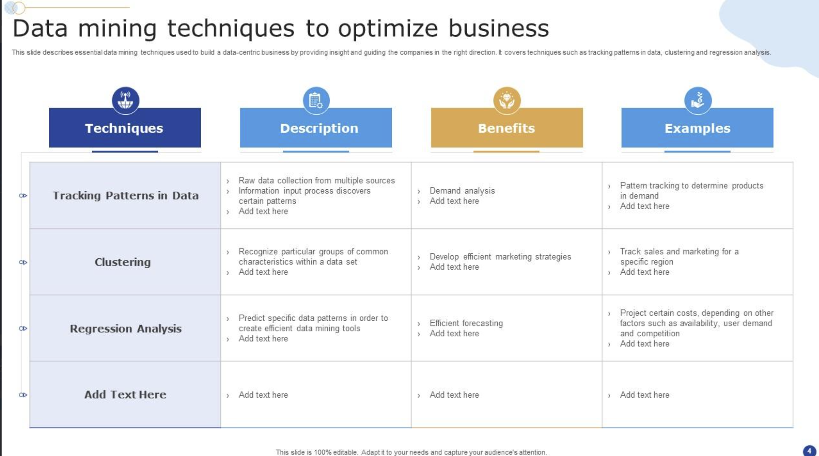

Slide 6
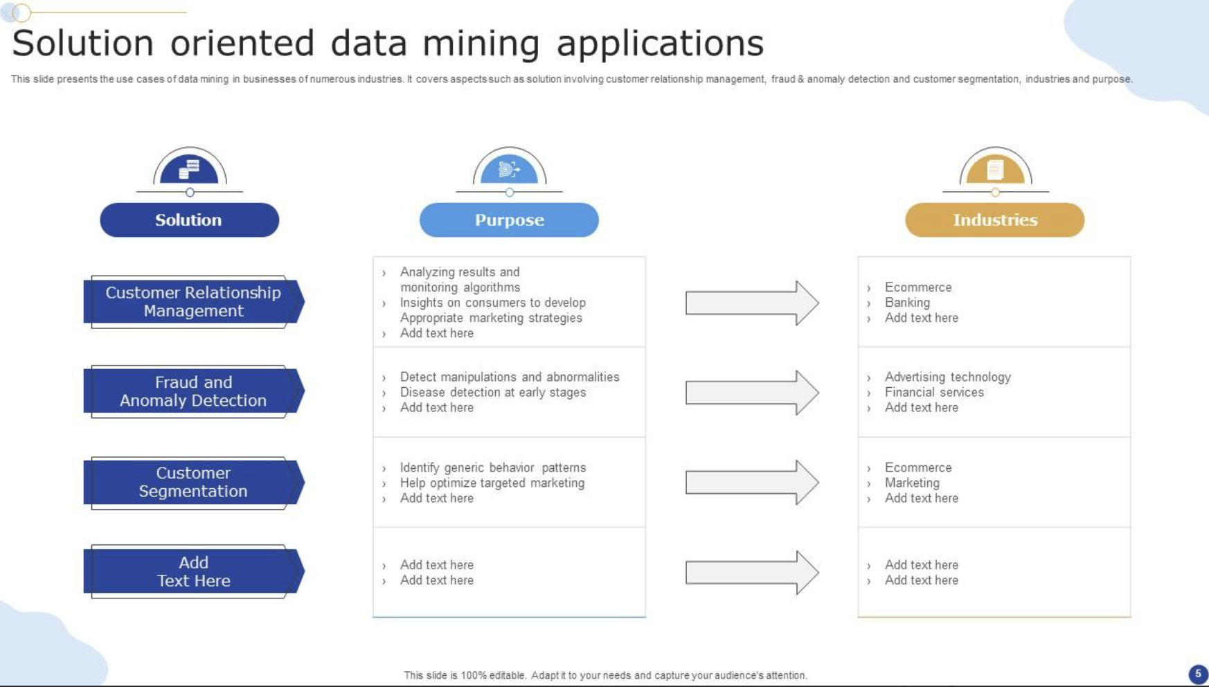

Slide 7
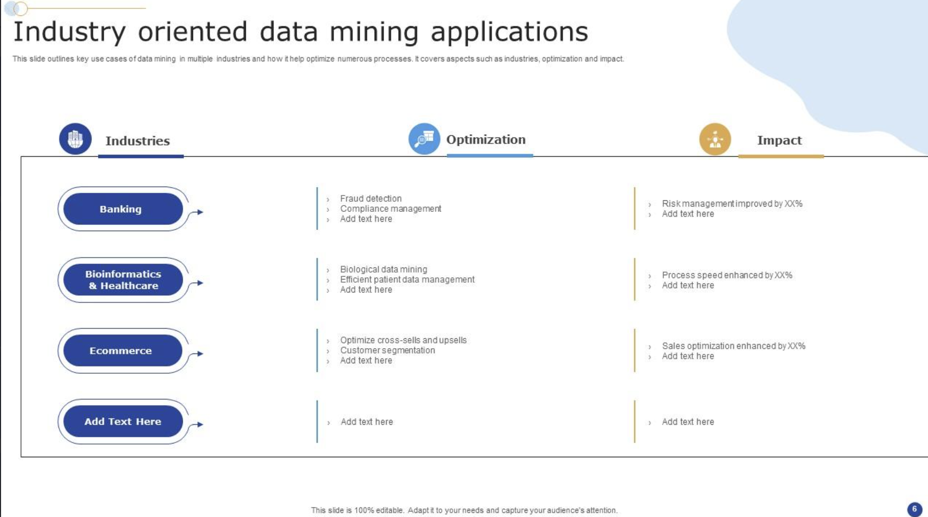

Slide 8
