Slide 1
Sri Ganesh College of Arts and Science
Department of Computer Applications
MOBILE COMPUTING
Speaker : Mr.E.PRABU

Slide 3
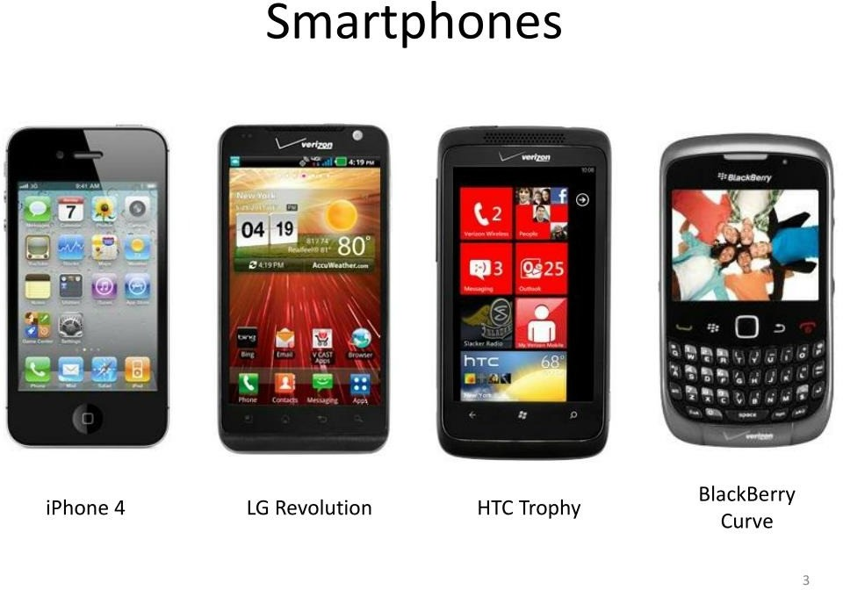

Slide 4
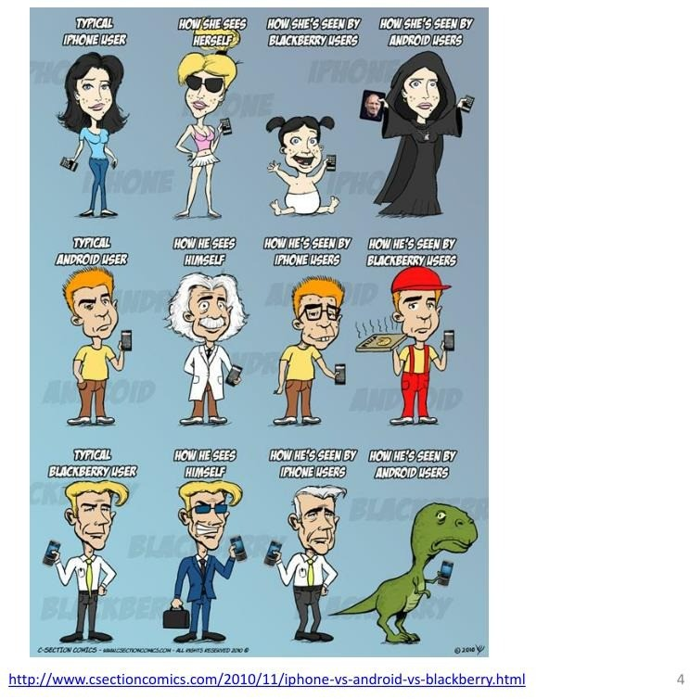

Slide 17
