Slide 1
Sri Ganesh College of Arts and Science
Department of History
INDUS VALLEY CIVILLIZATION
Speaker : V.SARAVANAN

Slide 2
The Harappan culture existed along the Indus River in what is present day Pakistan.
It was named after the city of Harappa.
Indus Valley
Harappa and the city of Mohenjo-Daro were important centers of the Indus valley civilization.
This Indus Valley “civilization” flourished
around 4000-1000 B.C.

Slide 3
Trade networks linked this culture with related regional cultures and distant sources of raw materials, including lapis lazuli and other materials for bead-making.
Domesticated crops included peas, sesame seeds,
Early Harappan –Ravi Phase 3300-2800 BC
This distinctive, regional culture which emerged is called Early or Pre-Harappan.
dates and cotton.
Domestic animals also used, such as the water buffalo.
Mud brick for building.

Slide 4
Middle Harappan-Integration ERA 2600-1900 BC
By 2500 BCE, communities had been turned into
urban centers (integration).
Six such urban centers have been discovered, including: Harappa, Mohenjo Daro and Dicki in Pakistan, along with Gonorreala, Dokalingam and Mangalore in India.
In total, over 1052 cities and settlements have been found, mainly in the general region of the Ghaggar-Florence River and its tributaries.
Irrigation used to increase crop production and mud brick structures.

Slide 5
Late Harappan-Cemetery 1700-1300 BC
Cremation of human remains. The bones were
stored in painted pottery burial urns. This is
completely different to the Indus civilization
where bodies were buried in wooden coffins.
Reddish pottery, painted in black with antelopes, peacocks etc., sun or star motifs, with different surface treatments to the earlier period.
Expansion of settlements into the east.
Rice became a main crop.
Apparent breakdown of the widespread trade of the Indus civilization, with materials such as marine shells no longer used.
Continued use of mud brick for building.

Slide 6
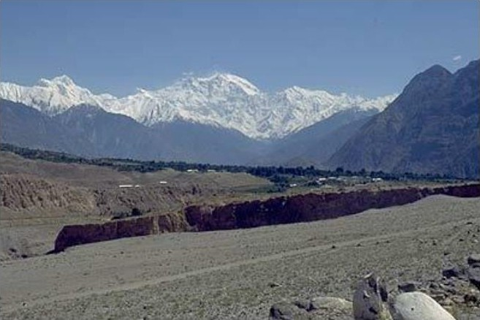
Himalayan Mountains
Nanga Parbat and
numerous other mountains of the Himalaya, Karakorum and
Hindu Kush provide a continuous source of water for the Indus and its tributaries.
These mountain ranges also provided important timber, animal products, and minerals, gold, silver, tin and
semiprecious stones
that were traded
throughout the Indus
Valley.

Slide 7
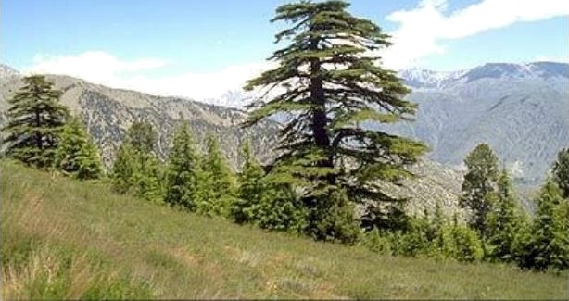
valley
Cedar in Chitral valley is still used to make houses and coffins, following a tradition that dates back to the first Indus cities.
Beyond the mountains in the background is the region of Badakhshan, Afghanistan, a source of the deep blue lapis lazuli.
This was mined during the Indus period and traded throughout the Indus Valley and to far off Ptesopotamia and Egypt.

Slide 8
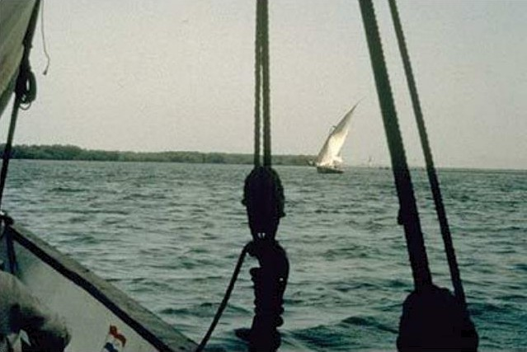
The coast of Sindh and Makran have
Coast
bays and ancient
arappan sites
have been located
along the coast to
the border of modernIran.
These coastal
settlements were
involved in fishing
and trading, using
the monsoon winds
to travel back and
forth to Oman and the Persian Gulf
region.

Slide 9
The cities are well known for their impressive, organized and regular layout.
They have well laid our plumbing and drainage system, including indoor toilets.
Harappa
Over one thousand other towns and
villages also existed in this region.

Slide 10
The similarities in plan and construction between
Cities
Mohenjo-Daro and Harappa indicate that they
were part of a unified government with extreme
organization.
Both cities were constructed of the same type and shape
of bricks.
The two cities may have existed simultaneously and
their sizes suggest that they served as capitals of their
provinces.
In contrast to other civilizations burials found from
these cities are not elaborate; they are more simplistic
and contain few material goods.
Remains of palaces or temples in the cities have not
been found.
No hard evidence exists indicating military acti ”I
though the cities did contain fortifications and artifacts
such as copper and bronze knives, spears, and
arrowheads were recovered.

Slide 11
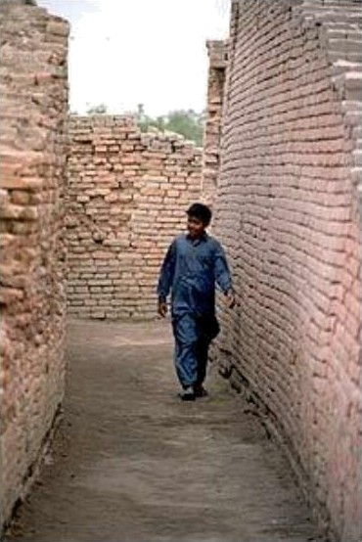
Streets
At Mohenjo-Daro narrow streets and alleyways are off of the major streets, leading into more private neighborhoods.
Many of the brick houses were two stories high, with thick walls and high ceilings to keep the rooms cool in the hot summer months.

Slide 12
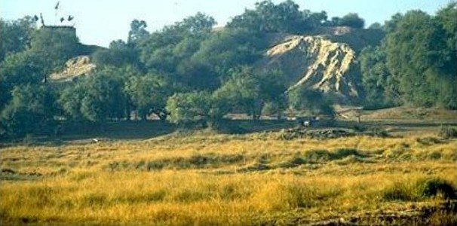
The high mound at Harappa (Mound AB) is surrounded by a massive mud brick city wall with large square ramparts.
One of these eroding ramparts is visible throug h the underbrush that now covers the site. The flags mark the tomb of a Muslim sa int.
Harappa

Slide 13
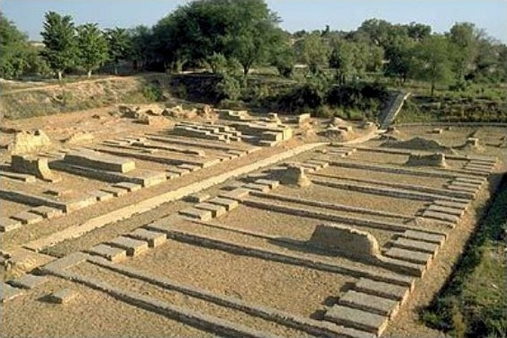
Granary
The "granary” of Harappa is found on Mound F.
It is a brick structure that was built on a massive brick foundation over 45 meters north-south and 45 meters east-west.
Two rows of six rooms that appear to be foundations are arranged along a central passageway that is about 7 meters wide and partly paved with baked bricks.
Each room measures 15.2 by 6.1 meters and has three sleeper walls with air space
between them.

Slide 14
The Indus (or Harappan) people used a pictographic script. Some 3500 specimens of this script survive in stamp seals
carved in stone, in molded terracotta and faience amulets,
Language
in fragments of pottery, and in a few other categories of
inscribed objects.
In addition to the pictographic signs, the seals and amulets
often contain iconographic motifs, mostly realistic pictures of animals apparently worshipped as sacred, and a few cultic scenes, including anthropomorphic deities and worshippers.
This material is important to the investigation of the Harappan language and religion, which continue to be major issues.

Slide 15
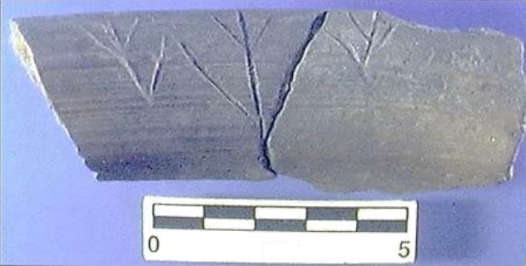
The origins of Indus writing
The origins of Indus writing can now be traced to the Ravi Phase (c. 3300-2800 BC) at Harappa.
Some inscriptions were made on the bottom of the pottery before firing.
This inscription (c. 3300 BC) appears to be three plant
symbols.
C III

Slide 16
Ancient
SCR I PT
SIG N
MEAN I NG
Arc h a ie
S u mer ian
mountain
hill country
foreign country
H ierog Iy ph i c
L qy ptian
hi II con ntry foreign country mountan
Archaic
Chinese
mountain hill mound
H ieroq Iy ph ic
H ittite
citadel
country
Anm ent
Indus

Slide 17
The Harappan civilization was mainly
urban and mercantile.
Inhabitants of the Indus valley traded with
Mesopotamia, southern India, Afghanistan, and Persia for gold, silver, copper, and turquoise.

Slide 18
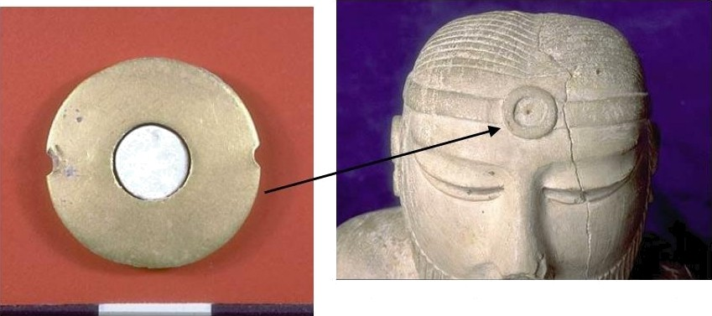
Trade
The central ornament worn on the forehead of the famous "priest-king" sculpture from Mohenjo-daro appears to represent an eye bead, possibly made of gold with steatite inlay in the center.
Gold Disc

Slide 20
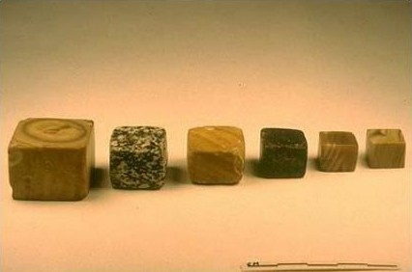
Cubical weights in graduated sizes.
These weights conform to the standard Harappan binary weight system that was used in all of the settlements.
The smallest weight in this series is 0.856 grams and the most common weight is approximately 13.7 grams, which is in the 16th ratio.
These weights were found in recent excavations at Harappa and may have been used for controlling trade and possibly for collecting taxes.

Slide 21
Harappan Astronoiv›y
Although the translation of the Harappan script is
still not complete, there are numerous indications
that Harappans were well versed in astronomy.
The straight streets of the Indus cities are oriented
towards tlae cardinal directions.
Astronomical evidence dates the compilation of the Vedic calendar at around the 23rd century B.C., when the Indus civilization flourished.
Like other urban civilizations, it undoubtedly
needed a calendar that adjusted to the lunar and
solar transitions.

Slide 22
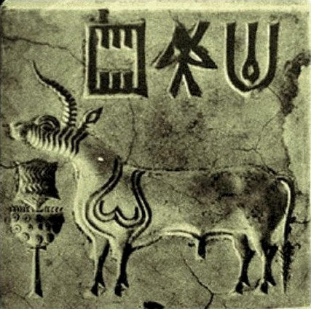
This unicorn seal was also discovered during the late 1927-31 excavations at Mohenjo-Daro.
One theory holds that the bull actually has two horns, but that these have been stylized to one because of the complexity of depicting three dimensions.
However the manufacturing and design process behind seals was so sophisticated that the depiction of three dimensions mig ht not necessarily have been a problem.

Slide 23
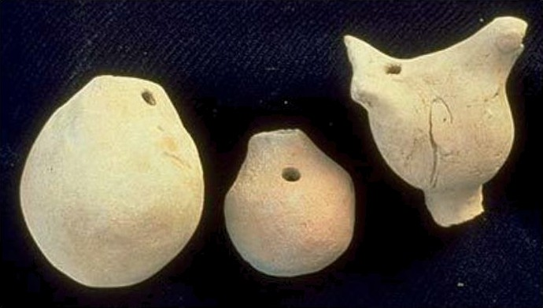
These egg shaped whistles may have been used for music, a tradition that is still present in rural areas of Pakistan and India.

Slide 27
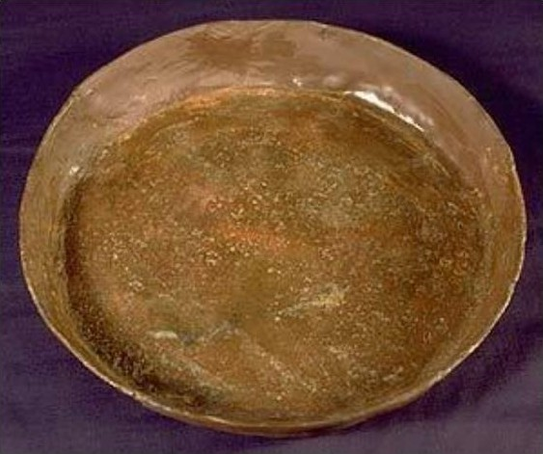
Copper plate with vertical sides.
Copper

Slide 28
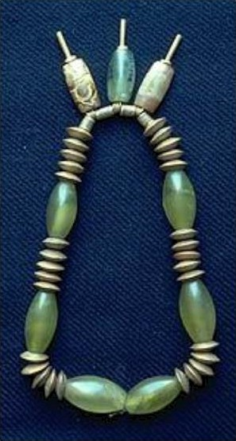
Necklace from Mohenjo- Daro made from gold, agate, jasper, steatite and green stone.
Necklace
The gold beads are hollow and the pendant agate and jasper beads are attached with thick gold wire.
Steatite beads with gold caps serve to separate each of the pendant beads.

