Slide 1
Sri Ganesh College of Arts and Science
Department of History
SANGAM AGE
Speaker : M.RAJAVENKATESWARAN

Slide 19
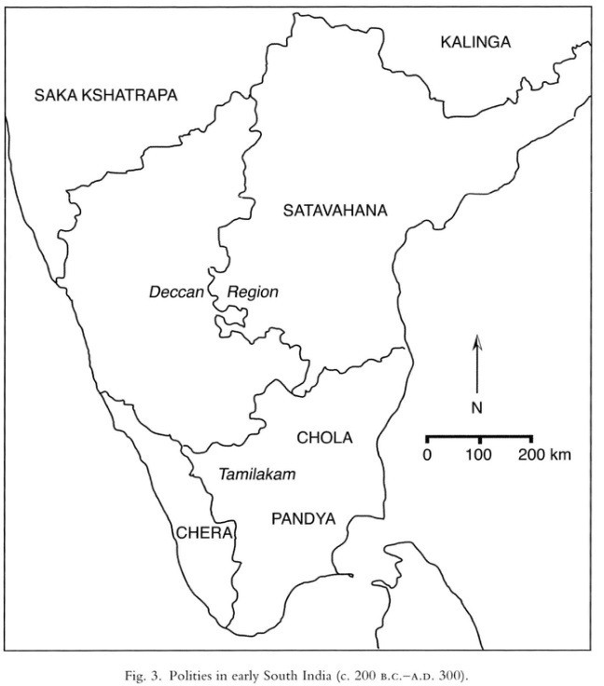

Slide 21
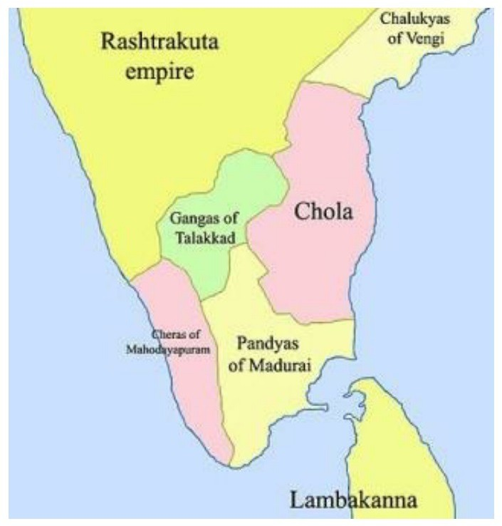

Slide 25
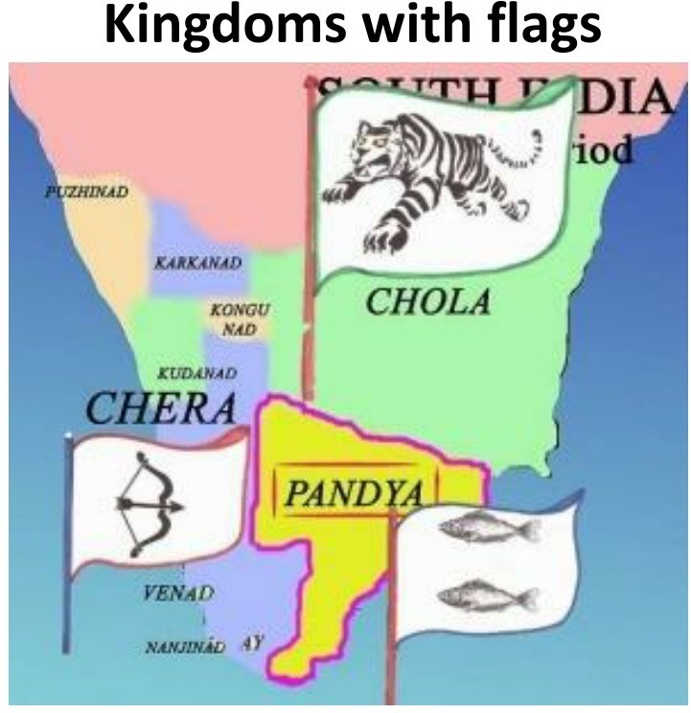

Slide 28
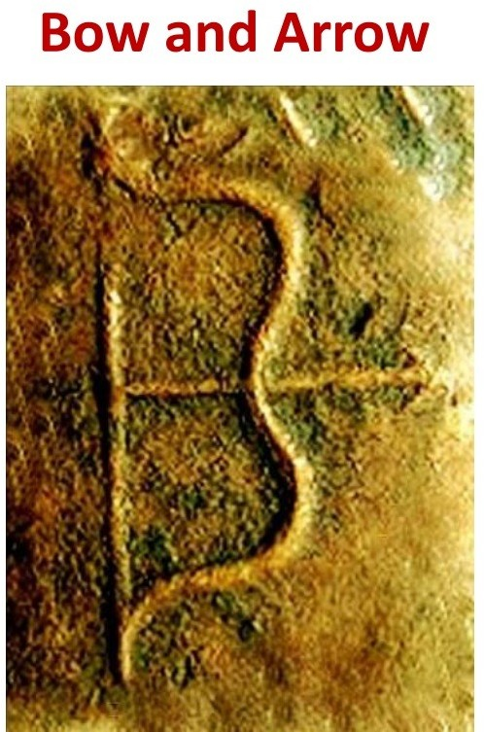

Slide 33
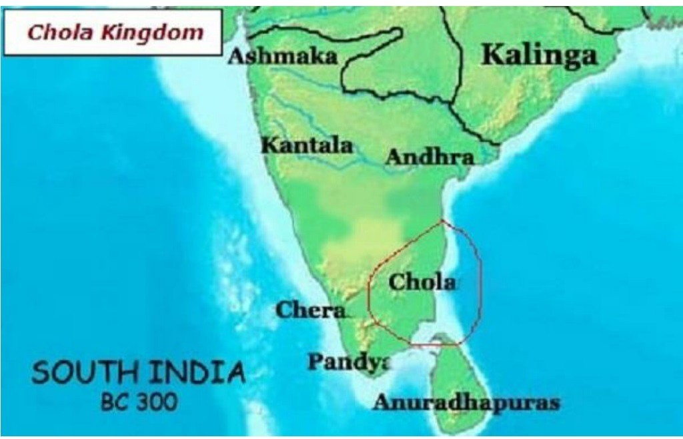

Slide 36
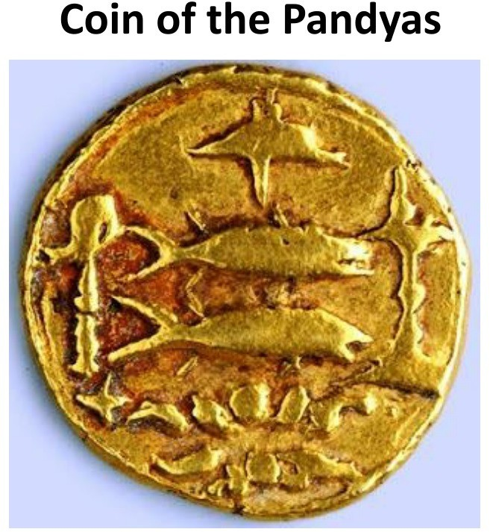

Slide 38
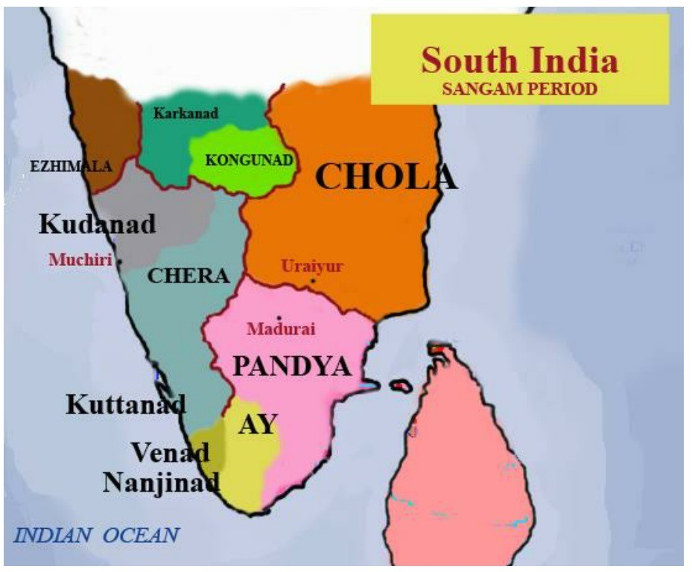

Slide 54
