Slide 1
Sri Ganesh College Of Art & Science Department Of Management Studies Business Law
Presented by:
J BALKEES
Assistant Professor
Department Of Management Studies

Slide 2
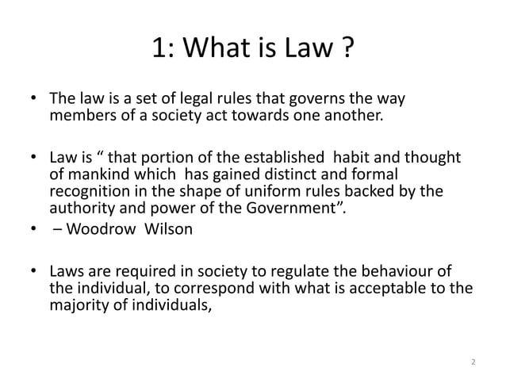

Slide 3
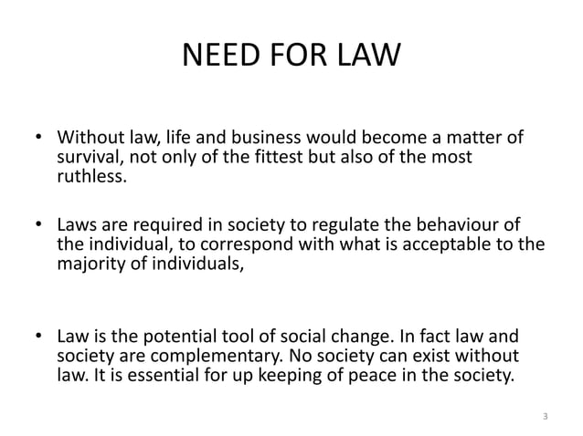

Slide 5
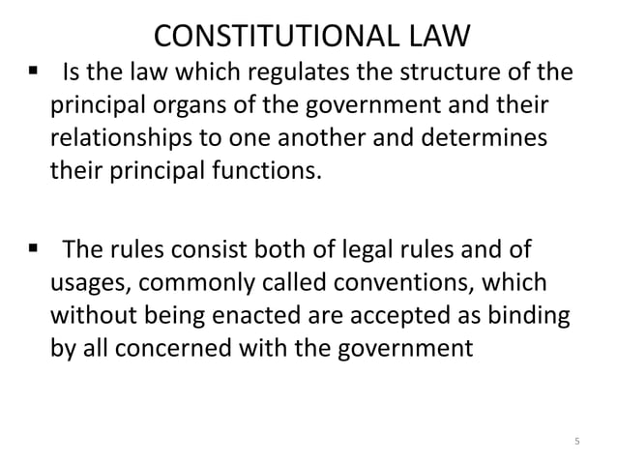

Slide 23
