Slide 1
SRI GANESH COLLEGE OF ARTS & SCIENCE,SALEM
HUMAN RESOURCE MANAGEMENT
done by
Mr.MEIGNANAM MBA,Mphil
Asst.Professor, Vidhyamandir College Of Arts & Science

Slide 4
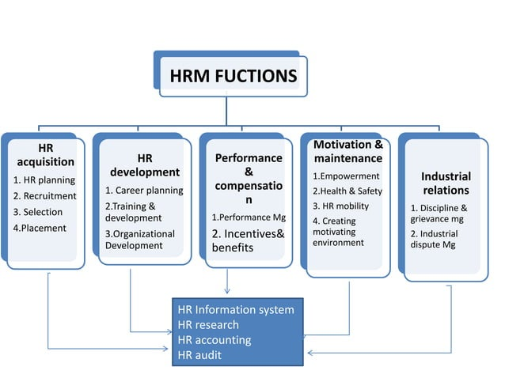

Slide 11
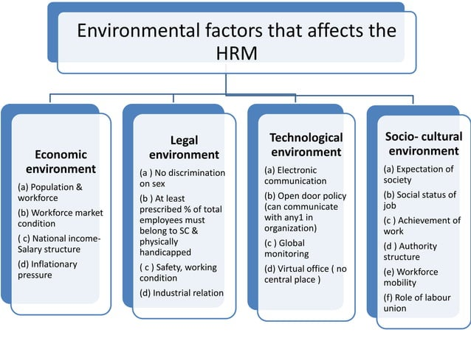

Slide 18
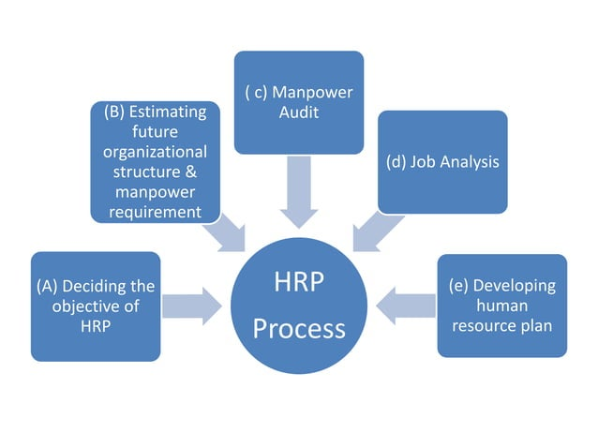

Slide 19
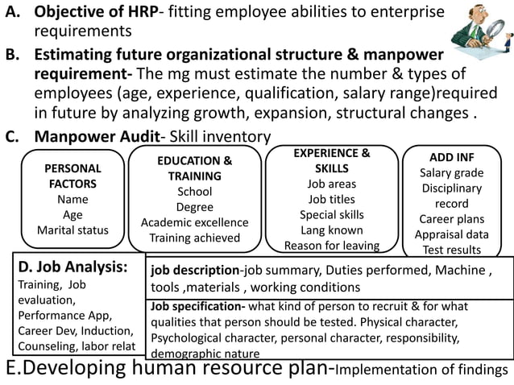

Slide 22
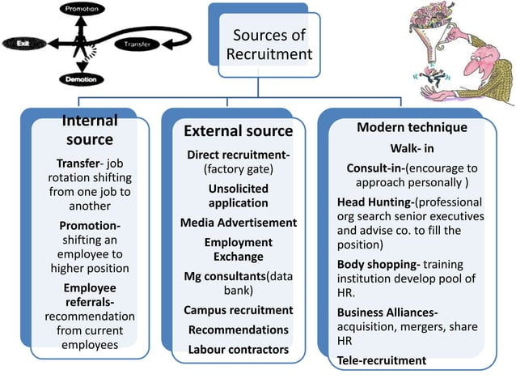

Slide 25
