Slide 1
SRI GANESH COLLEGE OF ARTS & SCIENCE DEPARTMENT OF MICROBIOLOGY
IMMUNE SYSTEM & IMMUNOLOGY
BY
M.SANGEETHA

Slide 14
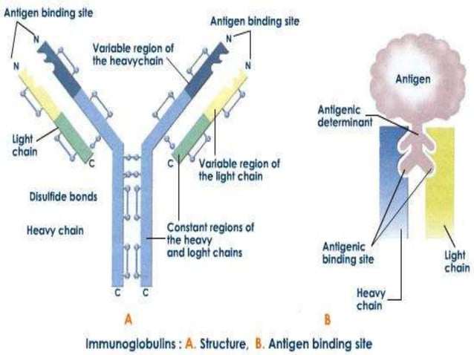

Slide 20
