Slide 1
SRI GANESH COLLEGE OF ARTS & SCIENCE DEPARTMENT OF MICROBIOLOGY
TYPES OF MICROSCOPES
BY
Dr.A.SUMITHRA

Slide 13
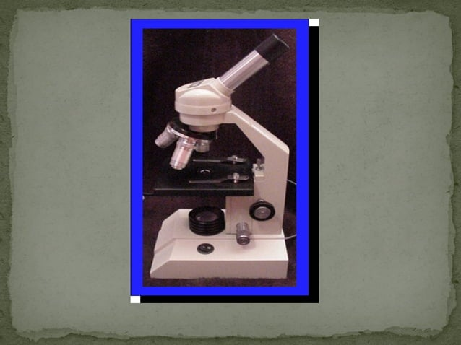

Slide 32
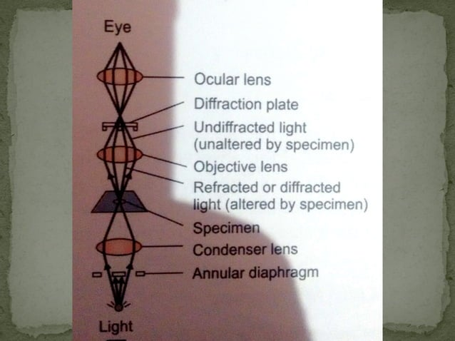

Slide 43
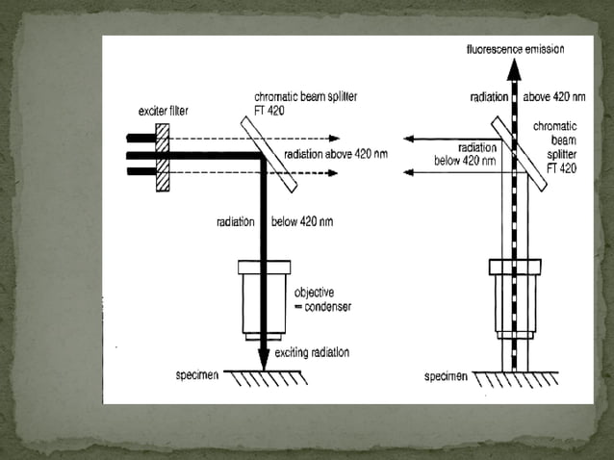

Slide 45
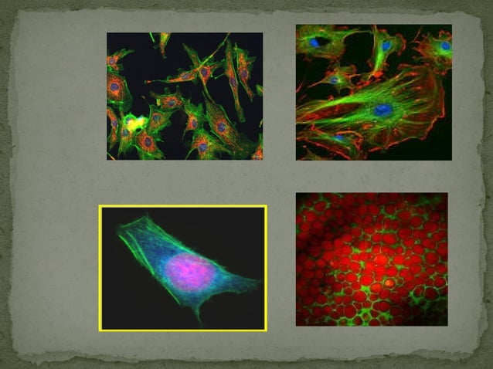

Slide 54
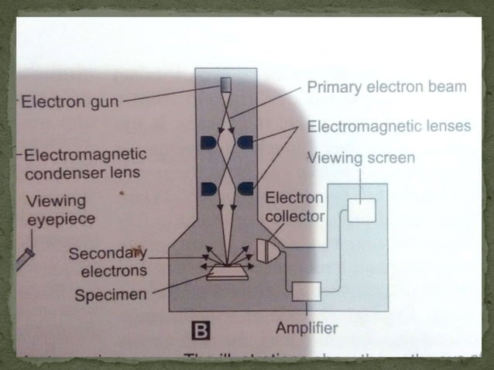

Slide 55
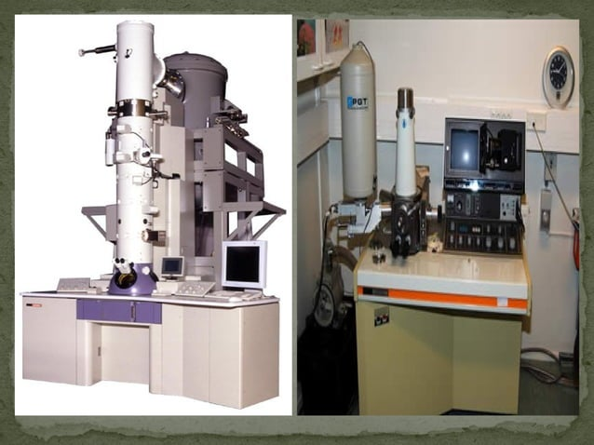

Slide 56
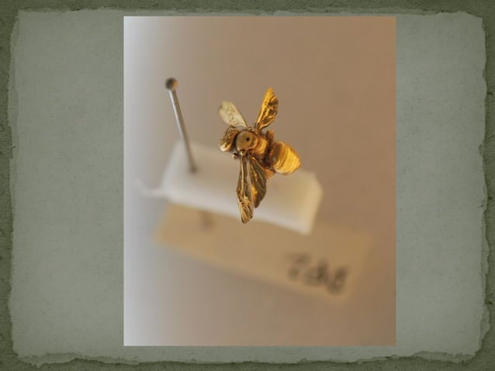

Slide 57
